Slide 1
The Napoleonic Era
1799-1815
http://www.history.com/topics/napoleon/videos/napoleon
Napoleon Cartoon – The History Channel

Slide 2
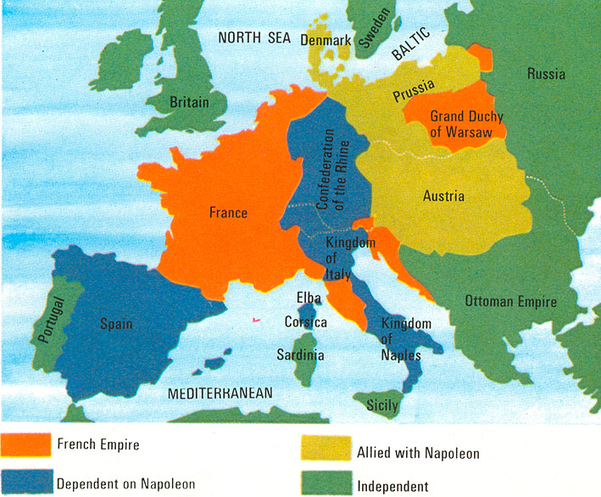

Slide 3
Napoleon Bonaparte
1769-born in Corsica
Attended military school in France
Joins army of the National Assembly
Appointed general of the French Army by the Directory in 1799.
“savior of the Republic” after successful cannonade (bombardment) to ward off conservatives
Over the course of 1 year, he takes back 9,000 square miles of former French territory.

Slide 4
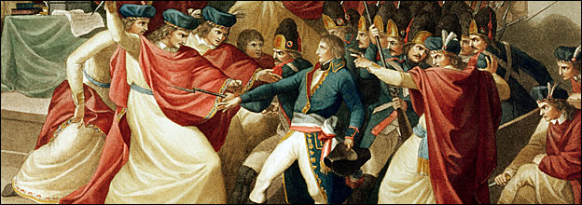
Coup d'etat = overthrow the State
November 9, 1799
Napoleon uses his military prestige and success to overthrow the Directory
Believed the Directory to be corrupt and not interested in serving the will of the people. The national legislature voted to dissolve the Directory.
This gave Napoleon dictatorial powers as head of the 1st consul.

Slide 5
French Consulate
November 10, 1799- French Consulate in place
3 leaders called Consuls
1st Consul- Napoleon Bonaparte
2nd and 3rd Consul – Jean Jacques Regis de Cambaceres and Charles-Francois Lebrun
1804 - In a sudden turn of events…….
Napoleon drafts a new constitution (4th in 8 years) naming him as 1st consul of France for life…unbeknownst to the other consuls. This is the true beginning of the Napoleonic Era!

Slide 6
Napoleon becomes Emperor
Plebiscite= by the people a vote of YES or NO on specific question (similar to a referendum in California today)
1800- plebiscite votes YES- 1st Consul of France
1802-plebiscite votes YES- 1st Consul of France for life
1804-plebiscite votes YES- EMPEROR OF FRANCE

Slide 7
Napoleon's Coronation
December 2, 1804
Napoleon’s Coronation
at
Notre Dame Cathedral
He takes the crown from the pope and places it on his head himself
Big controversy-WHY?? This signaled that he felt he was more powerful than the church.

Slide 8
Napoleon's Reforms
He was Enlightened but did limit some rights as well.
Reforms focused on four areas:
Economic reform
Social reform
Religious reform
Legal reform
Other improvements:
Brought order to France after the instability of the Revolution
Turned Paris into a beautiful city (parks, fountains, boulevards, etc…)

Slide 9
Economic Reform
Slowed inflation and equaled taxation = stable economy
Balanced budget
Set up a National Bank
Controlled circulation of money
Paid off debt
Sold Louisiana Territory to President Jefferson (3rd pres)
For $15 Mill (3 cents/acre), we made the Louisiana Purchase
Napoleon saw this as a way to finance his plans in Europe and give the British more headaches

Slide 10
Social Reform
Welcomed émigrés (nobles) back into govt positions on good behavior
Promoted officials by merit not nobility
Set up Lycees (public schools, which consisted of ordinary and wealthy children)
He would introduced the metric system to France

Slide 11
Religious Reform
Establish CONCORDAT (agreement) with the pope
New relationship b/w church and state
Allowed freedom of religion
However, he promoted Catholicism as “great majority” and “true” religion of France
Eliminated any political control of Pope
He emancipated Jews from laws that restricted them to ghettos.

Slide 12
Legal Reform
Established the Napoleonic Code of Laws (1st post king modern day laws)
Set of 101 new laws establishing strong sense of law and order , but simultaneously many of the laws placed big limitations on individual freedoms.
Equality under the law
Freedom of speech and press were limited
Censured newspapers
Reduced women’s rights (right to sell property)
Restored slavery in French Colonies of the Caribbean

Slide 13
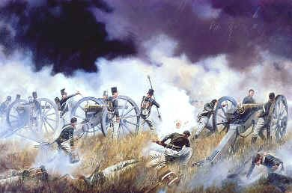
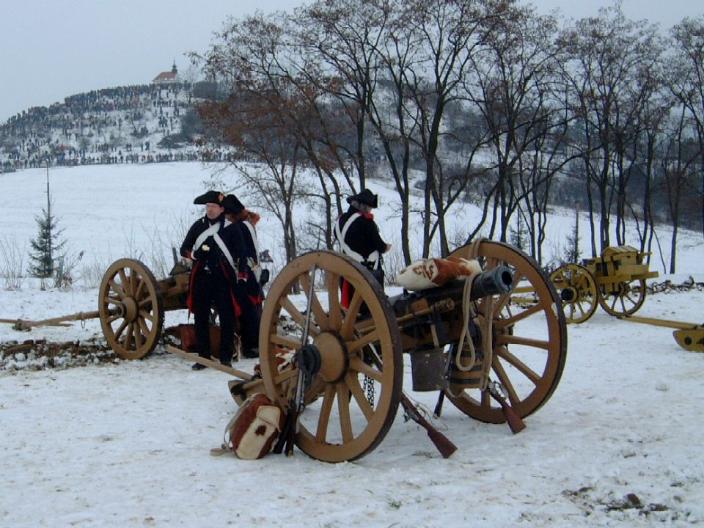
Military Mastermind
Military genius (Wellington said: “In this age, past ages, in any age, Napoleon is the greatest general”)
Expert in use of artillery
Developed innovative artillery strategy still in use today (i.e. mobile artillery: tank-like but lighter arms)

Slide 14
Napoleon: The Conquerer
Napoleon quickly forced his power across Europe
Battle of Austerlitz -December 1805 (see p. 207- Voices from the Past)
Invades Austria
Forces emperor to make peace and forms alliance
Battle of Jena -October 1806
Invades Prussia
Forces King to make peace and forms alliance

Slide 15
Napoleon: The Conqueror
Battle of Friedland: June 1807
Fought in Poland
Against Russians
Forces Czar Alex I to the bargaining table
PEACE OF TILSIT
Napoleon can have western ½ of Poland and all of Europe
Alex I can have eastern ½ of Poland and all Ottoman Empire
Peaceful coexistence
Non-aggression Pact

Slide 16
Napoleon's Europe
He appoints several of his brothers to thrones (Joseph – King of Spain, Louis -King of Holland), Lucien and Jerome also held high posts but all of them were in conflict with Napoleon at different times

Slide 17
Napoleon's ego gets in his way…
he becomes blinded by success and makes three fatal mistakes…
1. Continental System (attempted blockade of GB)
2. The Peninsular War (a result of non-compliance with the Continental System)
3. Invasion of Russia (a result of non-compliance with the Continental System)

Slide 18
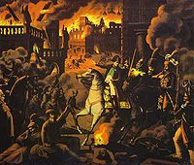
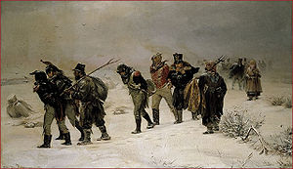
Continental System
1806
GOAL: to make Europe self-sufficient from GB and cripple GB
Blockaded GB goods into Europe
However, Russia still is selling grain to GB. This causes a breakdown in the alliance between Russia and France and eventually leads to the War of 1812

Slide 19
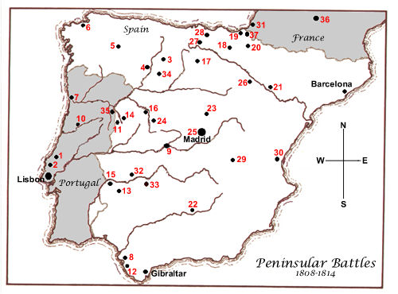
Peninsular War
1808-1813 (will overlap with Invasion of Russia)
Portugal is not participating in the Continental System, so he sends an army through Spain to attack Portugal for their non-compliance
On his way to Portugal, Spanish guerrillas (this is where it got its name from) fight in the name of NATIONALISM (it was a brutal, bloody war between the two). Britain will send aid to help the guerrillas.
Napoleon never gets Portugal and brother Joseph never gets to keep the crown as King of Spain (he ends up being exiled to Philly)
Napoleon losses 300,000 men greatly weakening his army.

Slide 20
Invasion of Russia
June, 1812
GOAL: quickly (Napoleon predicted a 20 day campaign) take Russia as punishment for breaking Continental System (selling grain to GB)
Invades with Grand Army of 600,000 men (many of these men were not from France and didn’t have high loyalty toward Napoleon to begin with)
Scorched-earth policy sucks him in (no food, water , shelter)
Wins at Moscow, but Czar won’t surrender. Winter sets in and he never gets Russia
December, 1812-Returns with 10,000 men
Beginning of the end for Napoleon

Slide 21
Kick him when he's down???
Europe has Napoleon at his weakest and decide to attack
Grand Alliance of Europe takes him on and wins
Exiled to Elba, but returns; Last 100 days
Finally defeated at the Battle of Waterloo (Belgium) by General Wellington of GB
Exiled again…but much further away—St. Helena (South Atlantic) under guard of GB. There are other inhabitants of the island, but none of them are family.
Dies on the island in 1821 (age 51). Cause of death never determined….some speculate stomach cancer, arsenic poisoning, neglect…..
Why don’t they (France or GB) just kill him?

Slide 22
Now that he's gone…what do we do?
Congress of Vienna (1814-1815)
GOAL: Restore order and stability in Europe
4 weeks of meetings turned into 8 mos.
Ring Leader and Host
Klemens von Metternich –Foreign Minister of Austria

Slide 23
Metternich's Agenda
Action Plan:
Encirclement of France
Strengthen countries around France
Prevent French aggression
Balance of Power
Restore balance so no country would be a threat to others in Europe
Legitimacy
Restore the monarchies deposed by Napoleon
Uphold conservative political ideals

Slide 24
Great Powers of Europe
Great Britain
Austrian Empire
Prussia
Russia
France
Was it right to keep France a great power?
Yes. A strong France is a strong Europe

